Slide 1
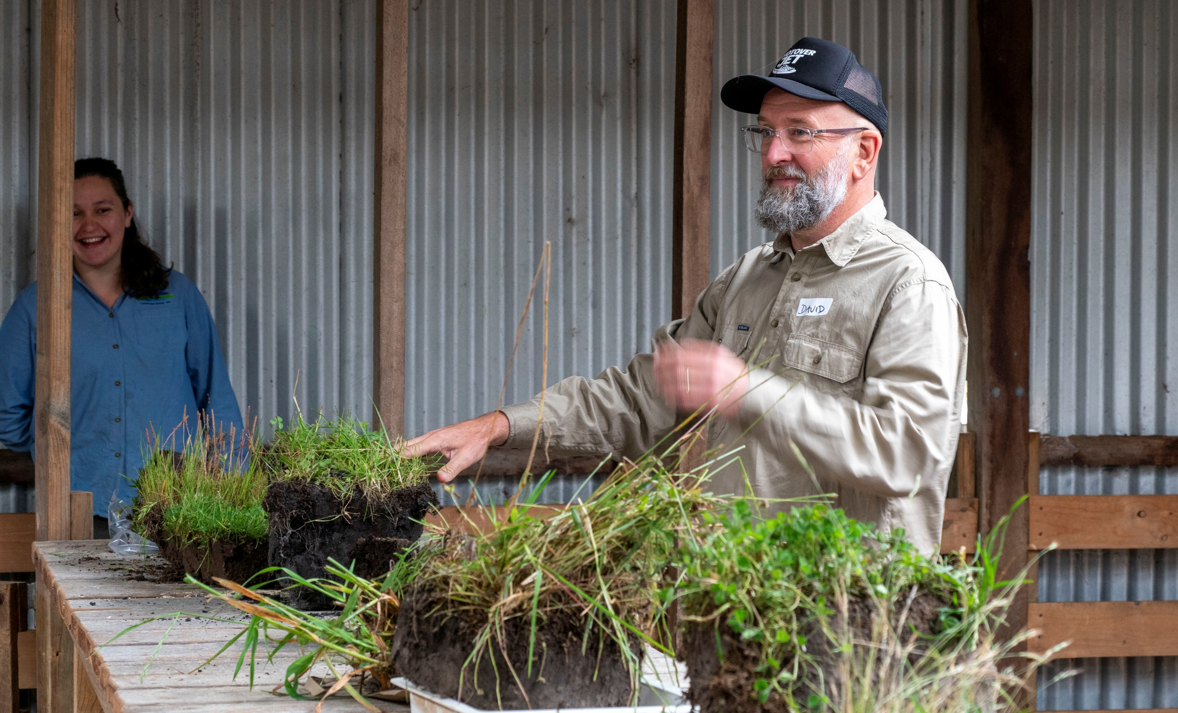




Soil health assessment workshop
Get soil health savvy!
Measure, monitor and manage your own property
Join us for a workshop with soil health expert David Hardwick. You will receive the following for FREE:
Results of extra soil tests from your farm’s samples
Advice on how to interpret these soil tests as indicators of soil health
A soil health assessment kit to take home
Advice to develop a plan to measure, monitor and manage soil health on your own property
Monday 31 March, 9am to 4pm
Location: The Barn MR, 294 Bridgelands Road, Rosa Glen
RSVP: https://lowerblackwood.com.au/events/soil_health_assessment_workshop/
Limited places and kits available, please RSVP as soon as possible
This project is part of Healthy Estuaries WA, a State Government initiative to improve the health of our South West estuaries.
This project is funded by the National Landcare Program Smart Farms Small Grants – an Australian Government initiative. It is supported by Healthy Estuaries WA – a State Government program.

