Slide 1
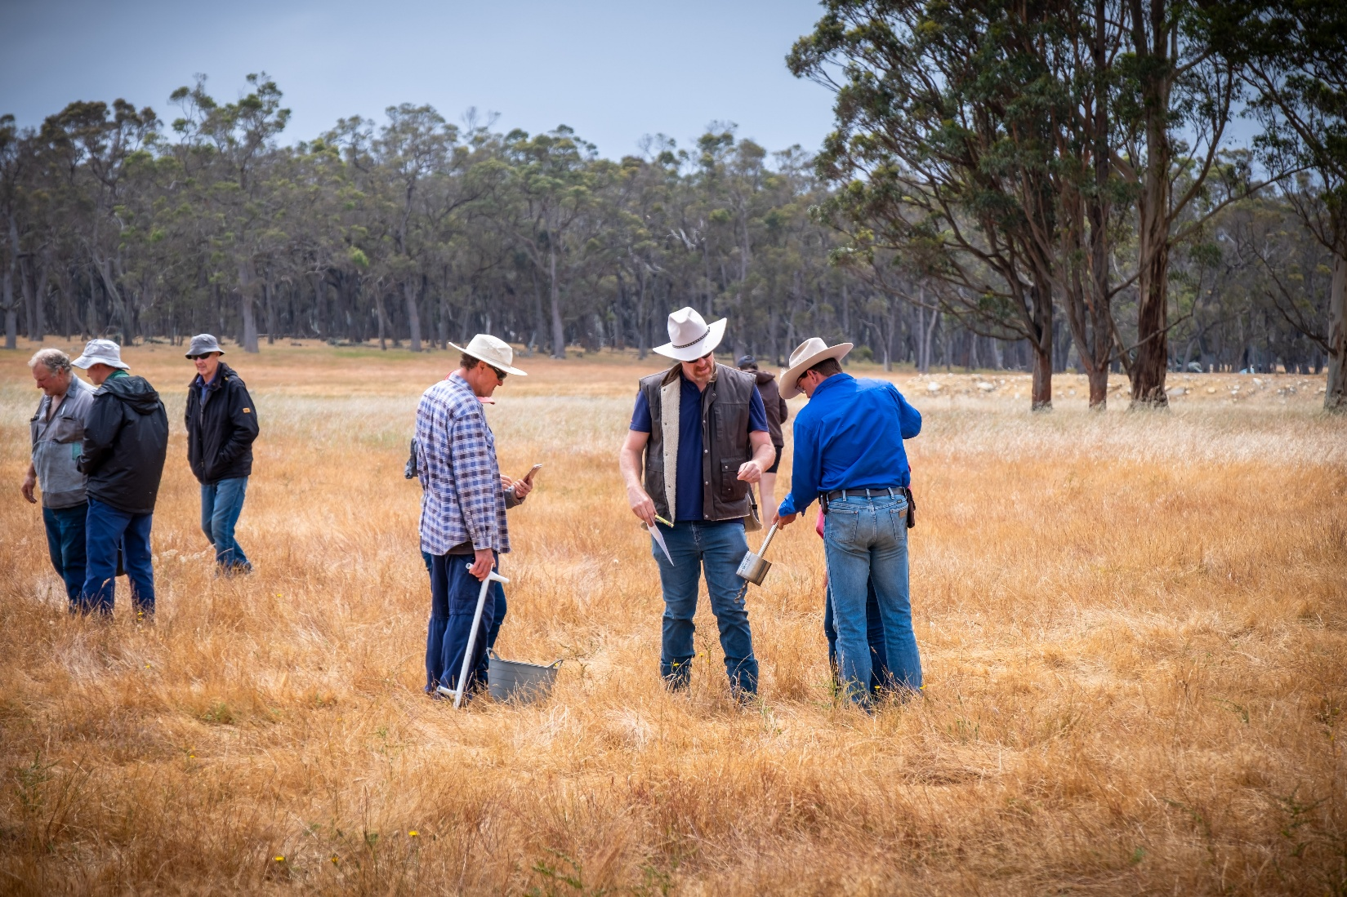

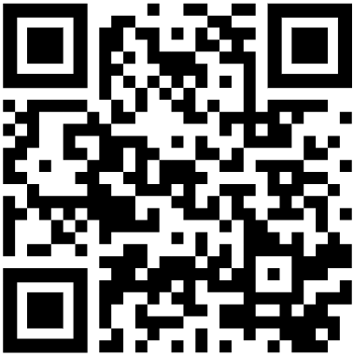


DIY soil sampling training day
Join fellow farmers to learn how to collect accurate soil samples.
The day will include hands on training and morning tea!
When: Thursday 13 November 2025 at 9:30am
Where: 157 Bussel Hwy, Margaret River
RSVP: by 6th November to Jourdyn
E: jourdyn.wells@lowerblackwood.com.au Ph: 0488 941 388
Training will be provided by DPIRD officers. You will learn how to:
Take accurate and representative soil samples of your farm.
Set-up the sampling drill and auger.
GPS your sample locations.
Use sample bags correctly.
This training is highly recommended.
It is essential for new participants of the DIY program, but everyone is welcome.
Alternative dates and locations
are available.
Prepare for the training:
Watch the short training videos.
Respect biosecurity on our host’s property.
Dress appropriately (hat, boots, fly net etc.).
Bring a water bottle and sunscreen.
Please bring a charged mobile phone or tablet (it must be cellular capable i.e. have a SIM card slot, but doesn’t need a SIM card).
If you have an Apple device, please install the Claris FileMaker Go app before the field day.
If possible, bring a charged 18V cordless drill.
This project is part of Healthy Estuaries WA, a State Government initiative to improve the water quality of our South West estuaries.

