Slide 1




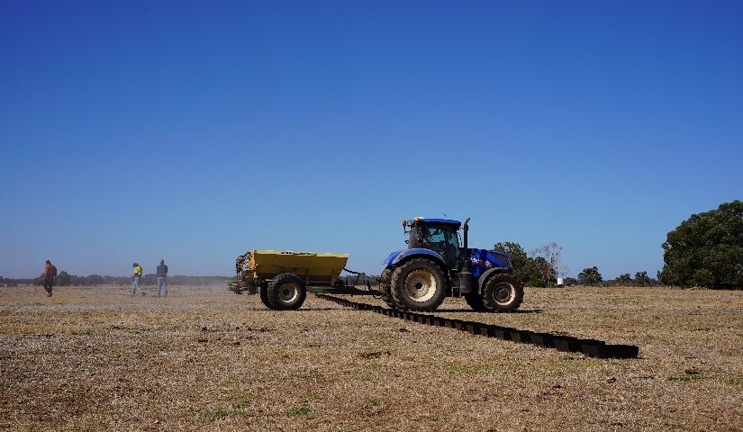
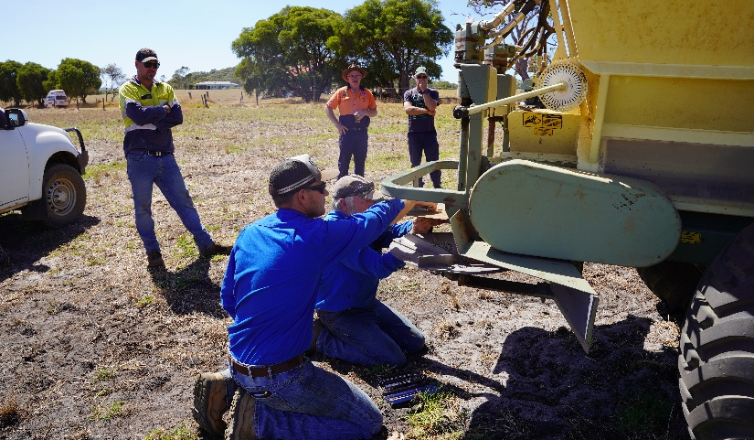


Is your spreader wasting fertiliser?
Join us at an Accu-Spread demonstration day to find out
Did you know that most fertiliser spreaders deliver highly variable spread patterns? This means some areas in the paddock receive too much fertiliser and others too little.
Join Australia’s leading Accu-Spread specialist Russell Nichol for a hands-on workshop demonstrating how to test and calibrate your own fertiliser spreading equipment. A calibrated spreader can help you get the most from your fertiliser investment and reduce nutrient loss to waterways.
Date: Friday 6 March, 9am to 3pm
Location: 343 Castle Rd, Nillup
Register: https://lowerblackwood.com.au/events/accu-spread-demonstration-day-2-342/
Lunch provided. Please register and specify any dietary requirements.
Let us know if you’d like your spreader to be tested (limited numbers!)
This project is part of Healthy Estuaries WA, a State Government initiative to improve the health of our South West estuaries.

